Slide 1



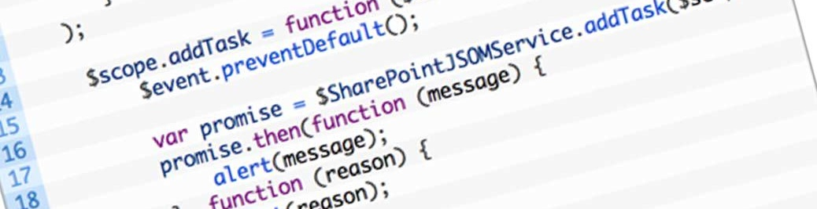
Introduction to AngularJS
Super Heroic JavaScript MVC Framework
SoftUni Team
Technical Trainers
Software University
http://softuni.bg

Slide 2


Table of Contents
What is AngularJS?
Introduction
MV* Frameworks
Features
Architecture
Components
Hello World Applications
Angular Seed
Required Software

Slide 3

What is AngularJS?

Slide 4
What is AngularJS?
AngularJS is a web applications framework
JavaScript framework for creating single page applications (SPA)
Free and open-source
Owned and maintained by Google
Extends traditional HTML to present dynamic content
Provides routing, templates, binding, etc.
MV*-based JavaScript framework

Slide 5
MV* Frameworks
Model – Represents data
View – Manages the display of information
* – Controller / Presenter / View Model
Model
ViewModel
Presenter
Controller
*
Controller / ViewModel / Presenter
View

Slide 6

AngularJS Features
Routing
Templates
Directives
Data binding
Expressions
Filters
Animations
Unit Testing

Slide 7
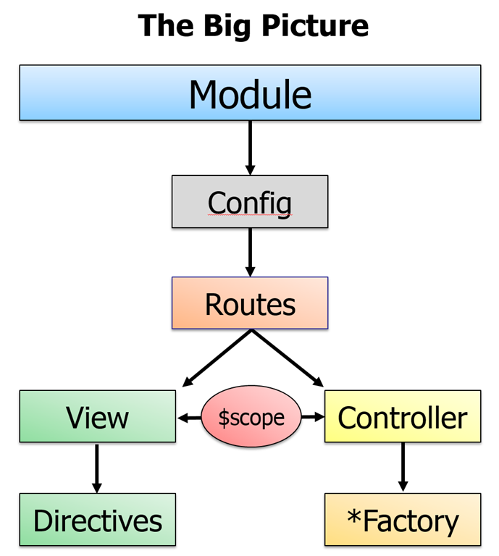
AngularJS Architecture
Two way data-binding
Dirty checking
Dependency injection

Slide 8
AngularJS Components
Services
Reusable Angular components
Built-in services (like $http) and custom services
Controllers
Hold the presentation logic
E.g. load data or handle button click
Views / Directives
Render the application UI

Slide 9

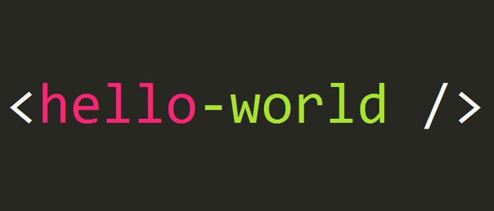
Hello World Application
Live Demo

Slide 10
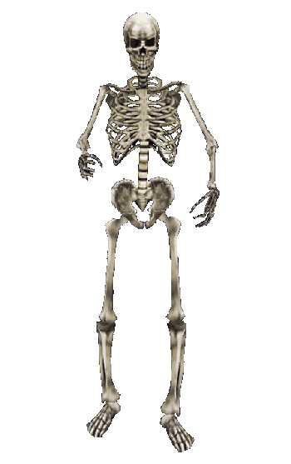
AngularJS Seed
Skeleton for AngularJS Web Application

Slide 11
What is AngularJS Seed?
AngularJS Seed == official applications skeleton
Perfect for small applications
It has good architecture
Contains sample unit tests
For bigger applications you need to modify it
Download from:
https://github.com/angular/angular-seed

Slide 12
AngularJS Seed
Live Demo

Slide 13
Required Software
AngularJS
https://angularjs.org
WebStorm / Sublime Text / other HTML5 editor
Web Server
E.g. a Node.js-based HTTP server or Apache
Console / Command Prompt

Slide 14


Summary
What is AngularJS?
What are the key features of AngularJS?
What is $scope in AngularJS?
What is two-way data binding?
JS Apps

Slide 15









Introduction to AngularJS
https://softuni.bg/courses/javascript-frameworks

Slide 16
License
This course (slides, examples, demos, videos, homework, etc.) is licensed under the "Creative Commons Attribution-NonCommercial-ShareAlike 4.0 International" license
Attribution: this work may contain portions from
"SPA with AngularJS" course by Telerik Academy under CC-BY-NC-SA license

Slide 17





Free Trainings @ Software University
Software University Foundation – softuni.org
Software University – High-Quality Education, Profession and Job for Software Developers
softuni.bg
Software University @ Facebook
facebook.com/SoftwareUniversity
Software University @ YouTube
youtube.com/SoftwareUniversity
Software University Forums – forum.softuni.bg

